Slide 1

Collaborative coding platform
Aniket Yadav^{#1}, Shreyash Pantawane^{#2}, Bhagyashree Alhat
aniketyadav@mitaoe.ac.in
sapantawane@mitaoe.ac.in
bralhat@comp.maepune.ac.in

Slide 2
ABSTRACT
In this new era of Computer Technology and Automation there is an outburst in new webs and apps which help people in their betterment. As we can see there has been huge development in Technology in the last decade. As of now we all are recovering from COVID-19 pandemic, in this period we got to know the importance of Computer technology. To develop Career in this field people need to know about coding and for doing so in groups so they can get help right in there so they can grow widely, the collaborative coding and editing sites must be there. This project is to help this type of people and lead them to be a master coder.

Slide 3
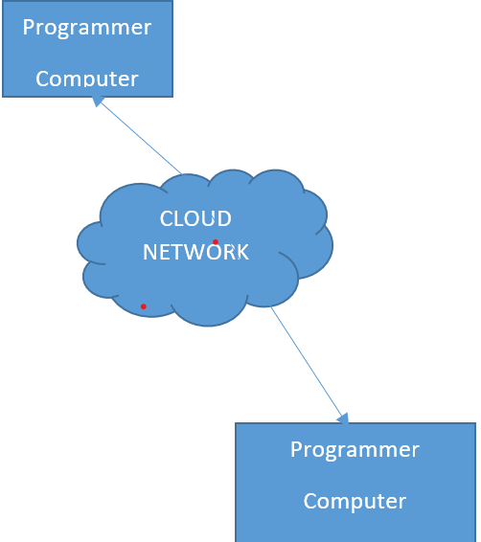
II. INTRODUCTION
This paper is based on developing a collaborative coding platform where the interviewer will be able to share the link of online IDE (our projects deployment) where attendee will write code, compile and debug. This will also help interview to avoid cheating on technical interviews. It is based on Cloud so each being can use the platform anywhere and anytime.

Slide 4
III. MOTIVATION
We had seen how easy is to copy code and explain it like it was written by the individual itself, same thing can occur at professional technical interviews as well, where student can copy the code assigned to him/ her from internet run it on personnel IDE and submit it like it was coded by himself. To avoid this mis-conduct we got motivated to develop an online IDE, where interviewer can monitor candidate on real-time while he/she is coding.

Slide 5
IV. LITERATURE SURVEY
[1] Challenges
This paper is an initial step to fill the gap between collaboration. The EarSketch and New Directions for Collaborative Live Coding in the Classroom : h API is built on top of JavaScript and Python so that EarSketch can be easy to used by students. Users can work either with their own uploaded sounds, or with 4000 available music samples that were engineer and tour DJ, which renders the tracks on the DAW view; and press the play button to listen to the result music.

Slide 6
[2] Using GITHUB in software engineering course: Analysis of students acceptance of collaborative coding platform:
Here experiment course is performed in the last semester of the bachelor’s degree study program and it builds on the knowledge that students acquired through the first five semesters. By adding software engineering theory and practices on top of analysis and specification, design, development, testing, deployment and documentation divided into up-to-five-member teams. Each team member was responsible for performing all aforementioned activities on four (plus/minus one) functional use cases (i.e. software tester and operations manager.

Slide 7
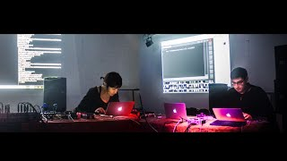
[3] Vivace: a collaborative live coding language and platform :
Vivace enables the emergence of the performance and makes it a kind of a collective game, where the rules, being visible to everyone through the code, eases audiences and specialists alike to join in. Live coding becomes a natural path to the type of use and technological development in which freak coders are involved

Slide 8
[4] Coding together - Coding alone: The role of trust in collaborative coding :
In this digital world, where we all want to grow fast and safer in small duration. The Collaborative Coding is a thing for them but while performing this technique/process all the team members must believe in each other. If any two members are not having a trust in each other, the project won’t be complete and for such people this process won’t work well. To overcome this, first you have to make sure what there won't be trust issues and each module and each unit is discussed very well before implementing.

Slide 9
VI. RELATED WORK
Weblinux: It is a web app tool providing a standard Linux OS and an IDE in the brows²er, including a terminal, a code editor and a file browser. It provides a client side and offline Linux OS environment based on a JavaScript emulated processor.
REPL base GoTTY: It is read–eval–print loop or language shell based approach in which user is provided with interactive computer programming environment (IDE) that takes single user inputs, executes, and returns the result to the user.

Slide 10
VII. METHODOLOGY
Here first Interviewer will register on projects website for organizing and scheduling the interview, then only link will be generated for the same.
Now on the scheduled time the Interviewer will ask the student to add to the same link for the interview.
After joining and agreeing to all agreements, the person giving the interview will be locked on the same platform.
Now its upto Interviewer to start the interview. He/She can access the features of tool such as blank document, paint sheet or ask the person to write the code on IDE attached on platform.
In this whole process data will be encrypted and stored on MongoDB for later use. Platform’s frontend is developed via HTML, CSS, JavaScript using Angular Framework.

Slide 11
VIII. COMPARISON
User testing, this approach is beneficial in two ways: communication, in addition to source-code editing. and tools for practitioners collaborating on data use to collaborate on data. Participants were recruited in two ways to reduce confusion and limit unsolicited emails, the institution’s computer science department. students and faculty. These contacts were generally computer science (or related) department. separately. Second, the recruitment email was sent to well professional announcements and international institutions. perceptions of the aforementioned applications was administered online through Qualtrics. In total, there were 23 faculty responses . Most faculty respondents (18/23) reported collaborating in realt ime. laborations. with specific examples from the survey responses. transfer, and DevOps. We see a lot of overlap in the types tools. Due to space constraints, some applications are not included in the table. Docs specifically. Two students did not mention currently . difficult to set up. laborations were mostly done through pair programming. Students revealed a desire for additional support. point things out. Our previous research confirmed similar.

Slide 12
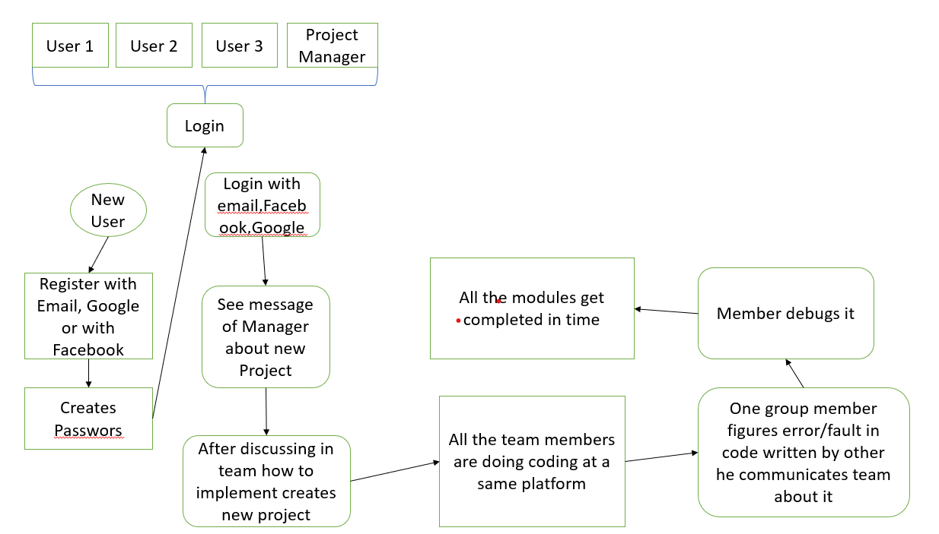
IX. TECHNIQUES
For the Front-End part we had used HTML, CSS and JavaScript using Angular framework.
In project we had implemented MEAN stake over MERN.
For Backend we had used MongoDB.
We implemented socket.io for connecting various nodes over local host
Fig. 1. Block Diagram

Slide 13
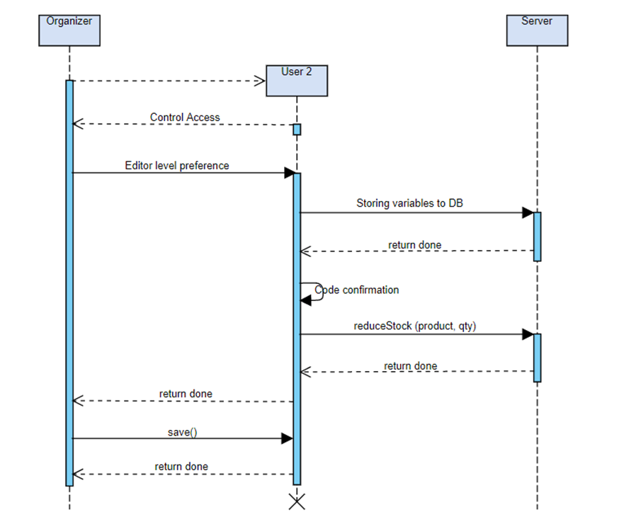
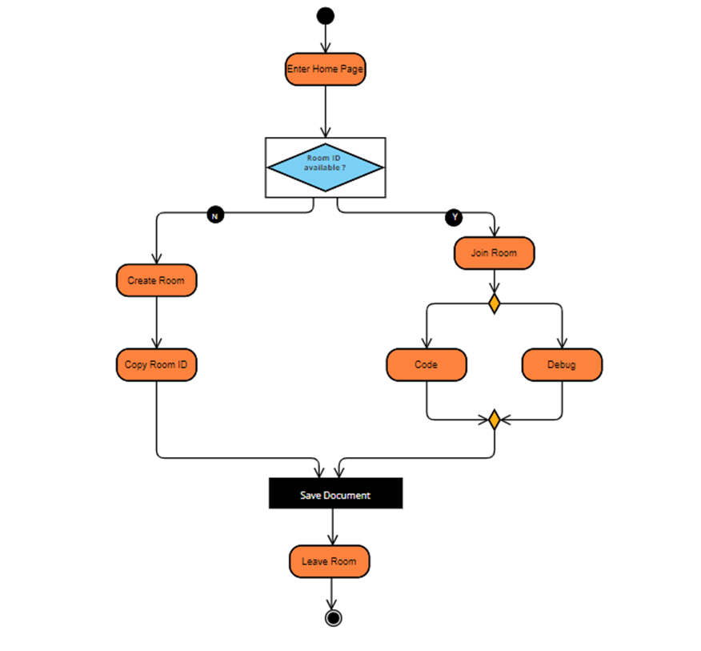
Fig.3 Activity Diagram
Fig.2 Sequence diagram

Slide 14
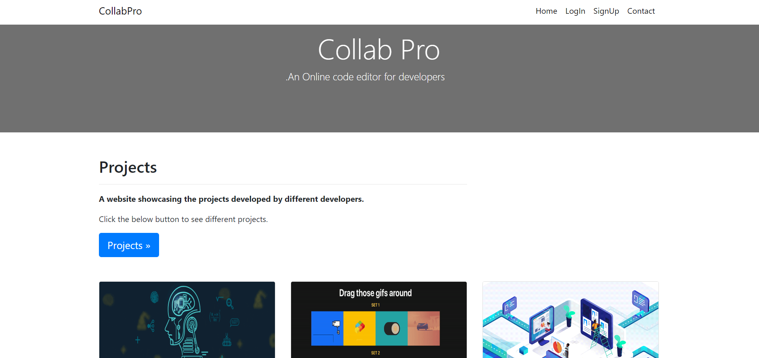
X. RESULT
Connection was successfully established using socket.io
Data processed in IDE is stored in backend using MongoDB.
Deployment was successfully done at Heroku platform.
Fig. 4 & 5 Implemented model

Slide 15
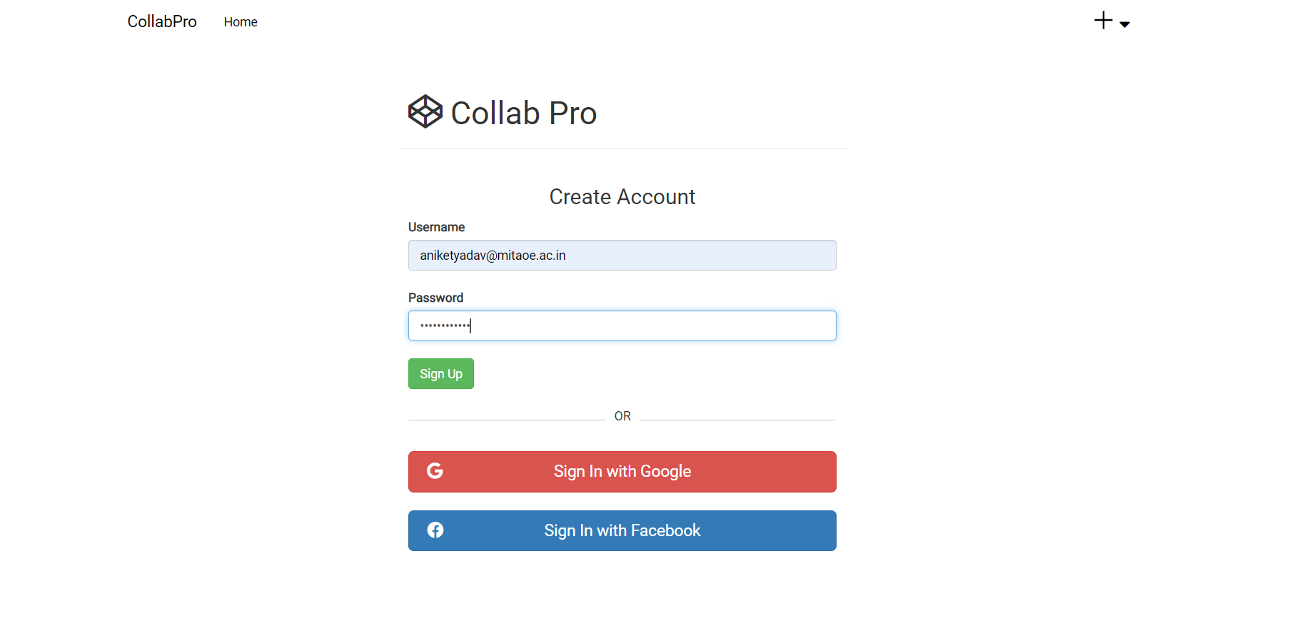

Slide 16
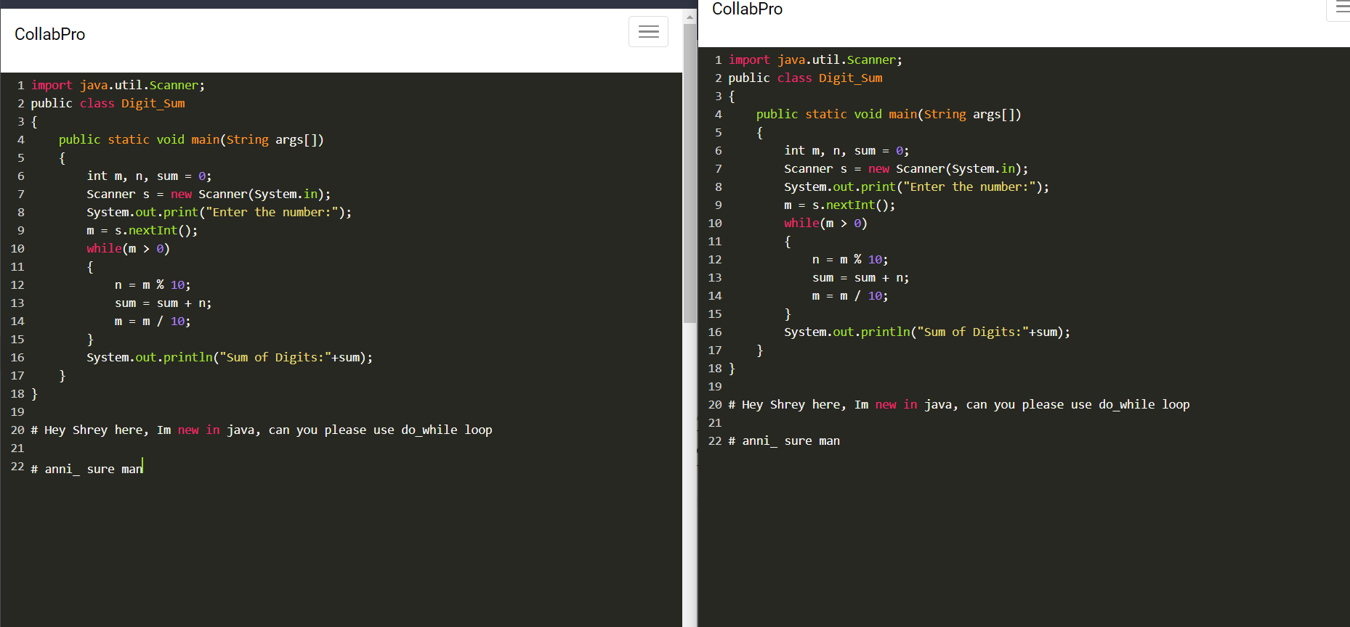
Live collaborating

Slide 17
XI. CONCLUSION
● Each collaborator will hold a copy of the shared document along with the server.
● In case different users are updating different part of the same document, server applies the changes to its copy and forwards the changes to other collaborators.
● Socket.io works properly for proper implementation of the project.
● Security has been increased via using multi-digit roomID code.

Slide 18
XII. REFERENCES
[1] Fiala J, Yee-King M, Grierson M. Collaborative coding interfaces on the Web. InProceedings of the International Conference on Live Interfaces 2016 Jun 29 (pp. 49-57). REFRAME Books, University of Sussex.
[2] Naganathan, G., Srikanthan, S., Balachandran, A., Gladdy, A. and Shanmuganathan, V., 2022. Collaborative Zoom Coding—A Novel Approach to Qualitative Analysis. International Journal of Qualitative Methods, 21, p.16094069221075862
[3] Saini R, Mussbacher G. Towards Conflict-Free Collaborative Modelling using VS Code Extensions. In2021 ACM/IEEE International Conference on Model Driven Engineering Languages and Systems Companion (MODELS-C) 2021 Oct 10 (pp. 35-44). IEEE.
[4] Xambó, A., Freeman, J., Magerko, B. and Shah, P., 2016. Challenges and new directions for collaborative live coding in the classroom. In International Conference of Live Interfaces (ICLI 2016). Brighton, UK.
[5] Sawant, S., 2021. Online Collaborative Learning Tools and Types: Their Key Role in Managing Classrooms Without Walls. In Human-Computer Interaction and Technology Integration in Modern Society (pp. 12-41). IGI Global.
[6] Coding together – coding alone: the role of trust in collaborative programming Fabian Stephany, Fabian Braesemann. University of Oxford. August 24,2019.

Slide 19
THANK YOU
Any Questions?

